Slide 1
Mathematic for Computer Science - III CS203B
Lecture 4:
Fundamentals of Elementary Probability Theory - III

Slide 2




5-Coins
Homework from last class
2 normal coins
2 coins with HEAD on both sides
1 coins with TAIL on both sides
A coin is picked randomly uniformly
and tossed.
$$\frac{3}{5}$$
Question:
What is probability that outcome of toss is HEAD ?
The outcome is
The same coin is tossed again.
$$\frac{5}{6}$$
Question:
What is probability that outcome of toss is HEAD ?
The outcome is
The coin is thrown away.
A new coin is picked randomly and tosses.
$$\frac{21}{40}$$
Question:
What is probability that outcome of toss is HEAD ?

Slide 3
Partition of Sample SPACE
A powerful technique to analyse some probability problem

Slide 4

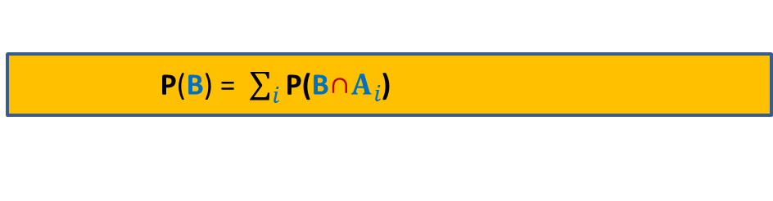




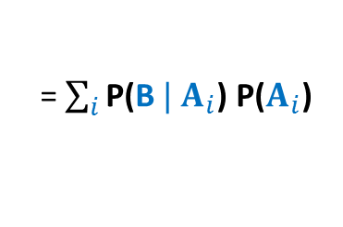


Partition of sample space
A set of events $A_{1}$,…, $A_{n}$ defined over a probability space ($Ω$,P)
is said to induce a partition of $Ω$ if
$\bigcup_{i=1}^{n}{A_{i}}$ = $Ω$
$A_{i}\bigcap{A_{j}}$ =∅ for all$i≠j$
For an event B, how can we express P(B) in terms of a given partition ?
$$A_{6}$$
$$A_{5}$$
$$A_{4}$$
$$A_{1}$$
B
$$A_{3}$$
Ω
$$A_{2}$$
P(B) = $\sum_{i}{\text{P}\text{(}\text{B}\text{∩}A_{i}}$)
= $\sum_{i}{\text{P}\text{(}{\text{B} | A}_{i}}$) $\text{P}\text{(}A_{i}$)

Slide 5


Sticks problem
$n$ sticks of different heights.
$n$ holes in a straight line.
Question:
What is probability that stick at $i$th place is visible ?
$$i$$

Slide 6





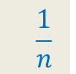







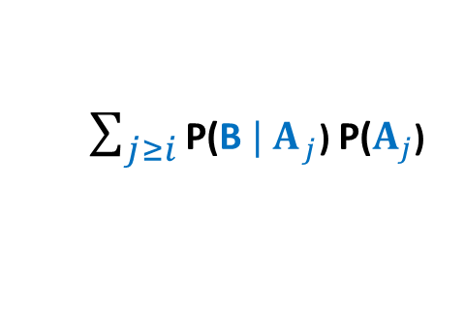



Sticks problem
$n$ sticks of different heights.
$n$ holes in a straight line.
Question:
What is probability that stick at $i$th place is visible ?
B :
the stick at $i$th place is visible
Set {$A_{j}$ | $1≤j≤n$ } is a partition of $Ω$.
$A_{j}$ :
the $j$th smallest stick is occupying $i$th slot
$$\frac{1}{n}$$
$\text{P}\text{(}\text{B}$) =
$\sum_{j≥i}{\text{P}\text{(}{\text{B} | A}_{j}}$) $\text{P}\text{(}A_{j}$)
$$\frac{1}{n−1!}$$
$$\left({j−1 \atop i−1}\right)$$
$$A_{4}$$
$$⋅\left(i−1\right)!$$
$$⋅\left(n−i\right)!$$
B
$j$th
smallest stick
$$A_{1}$$
$$A_{3}$$
Ω
A complicated expression
$$A_{2}$$
$$i$$

Slide 7









Sticks problem
$n$ sticks of different heights.
$n$ holes in a straight line.
Question:
What is probability that stick at $i$th place is visible ?
$g$ :
a subset of $k$sticks
$h$ :
a subset of $k$holes from [$n$].
Question:
Given that the holes of $h$
are occupied by the sticks of set $g$,
how are sticks of set $g$ distributed ?
Uniformly randomly among the holes of $h$
This hole is equally likely to be occupied by each stick of set $g$
This hole is equally likely to be occupied by each stick of set $g$
$$h$$

Slide 8


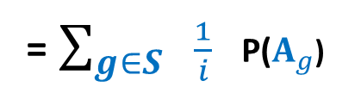








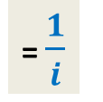



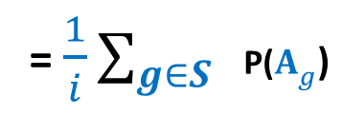



Sticks problem
$n$ sticks of different heights.
$n$ holes in a straight line.
Question:
What is probability that stick at $i$th place is visible ?
B :
the stick at $i$th place is visible
Set {$A_{g}$ | $g∈S$ } is a partition of $Ω$.
$S$ :
set of all subsets of $i$sticks
For any $g∈S$, define event
$A_{g}$ as follows
$A_{g}$ :
The first $i$ holes are occupied by sticks of set $g$
$\text{P}\text{(}\text{B}$) =
$\sum_{g∈S}{ \text{P}\text{(}{\text{B} | A}_{g}}$) $\text{P}\text{(}A_{g}$)
= $\sum_{g∈S}{ \frac{1}{i} }$ $\text{P}\text{(}A_{g}$)
=$1$
= $\frac{1}{i}\sum_{g∈S}{ }\text{P}\text{(}A_{g}$)
= $\frac{1}{i}$
B
This hole is equally likely to be occupied by each stick of set $g$
$$A_{g}$$
This hole is equally likely to be occupied by each stick of set $g$
$$A_{g′′}$$
Ω
$$A_{g′}$$
$$i$$
For $\text{B}$to happen,
the tallest stick among $g$
should occupy $i$th hole

Slide 9
Balls Out of BIN

Slide 10


Balls Out of Bin
There is a bin containing $r$ red balls and $b$ blue balls.
Balls are taken out from the bag
Question: What is the probability that appears ahead of all blue balls. ?
uniformly randomly
and without replacement.
What if $r$ = 1 ?

Slide 11
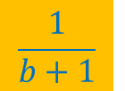
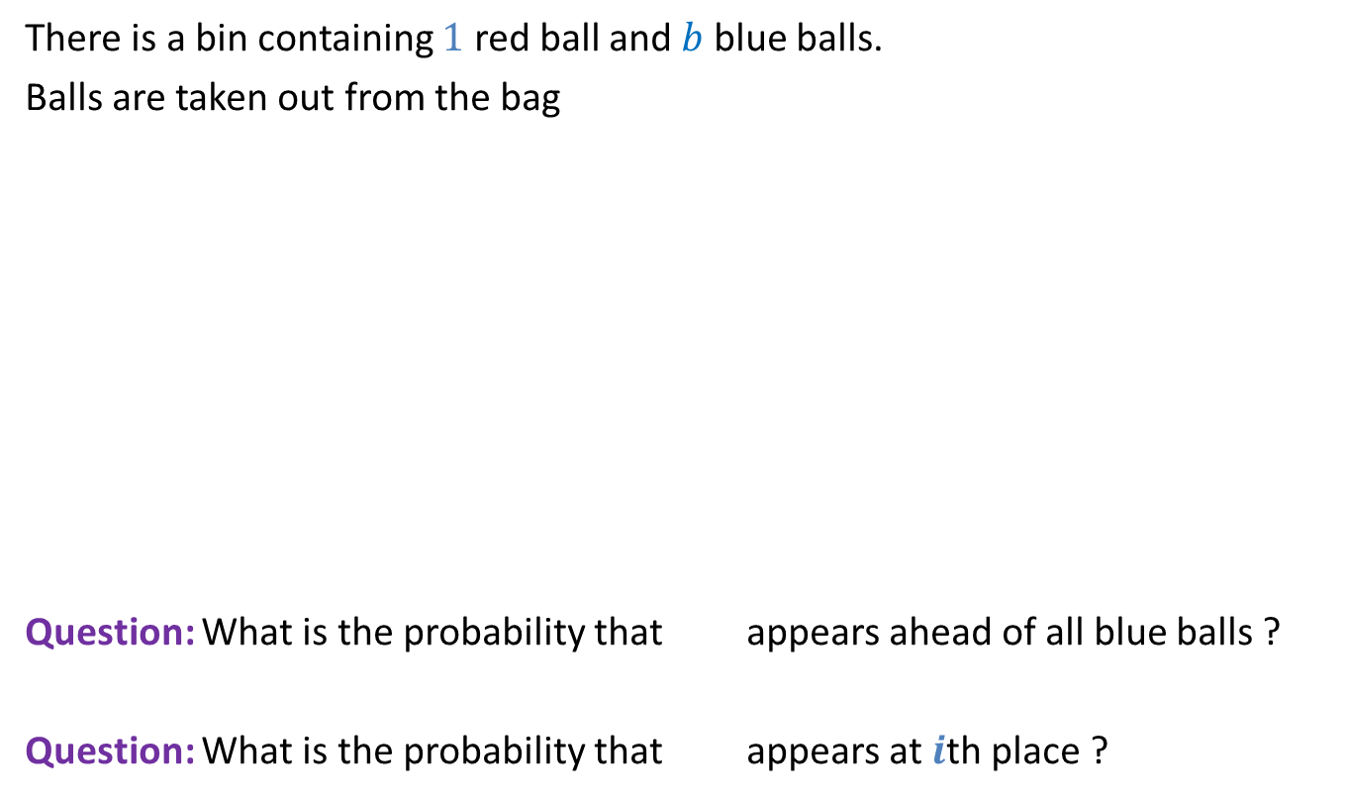
Balls Out of Bin
There is a bin containing $1$ red ball and $b$ blue balls.
Balls are taken out from the bag
Question: What is the probability that appears ahead of all blue balls ?
Question: What is the probability that appears at $i$th place ?
uniformly randomly
and without replacement.
$$\frac{1}{b+1}$$
$$\frac{1}{b+1}$$

Slide 12
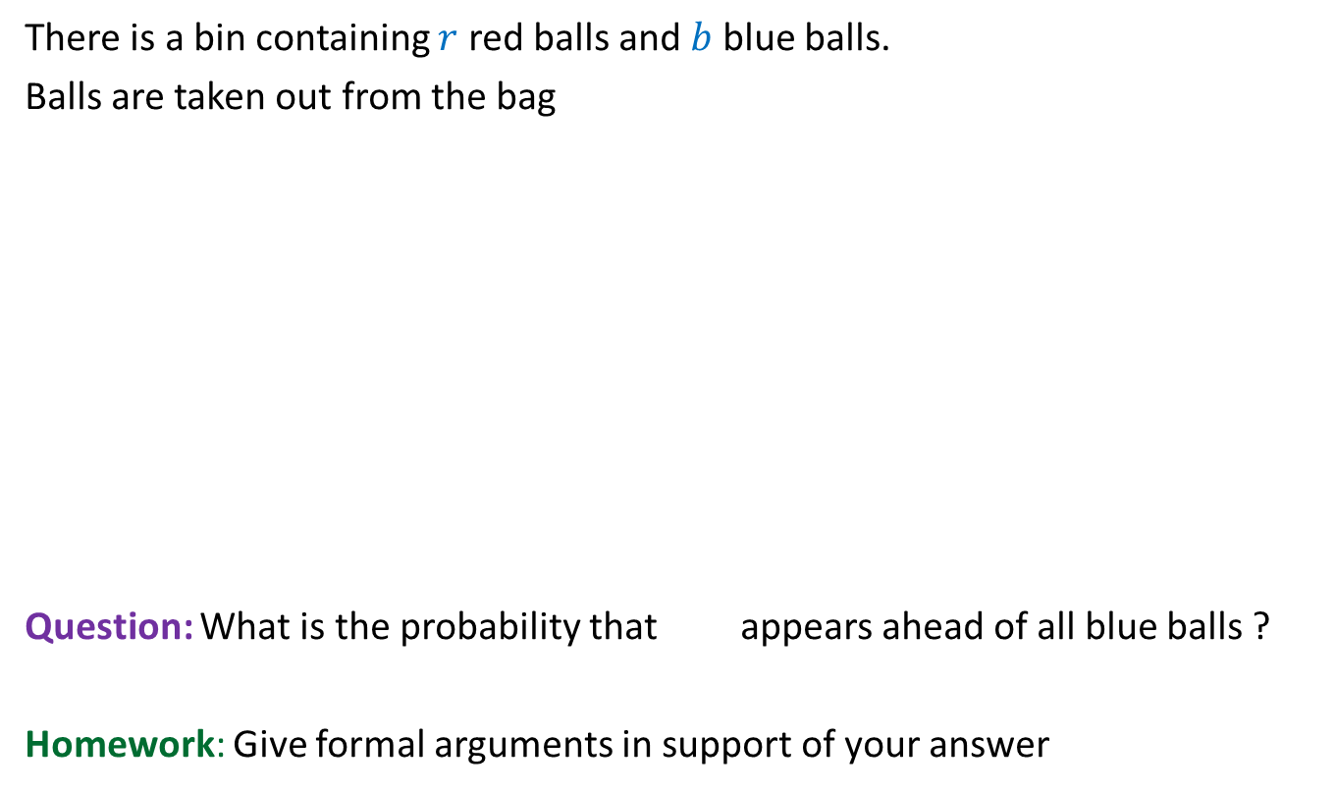
Balls Out of Bin
There is a bin containing $r$ red balls and $b$ blue balls.
Balls are taken out from the bag
Question: What is the probability that appears ahead of all blue balls ?
Homework: Give formal arguments in support of your answer
uniformly randomly
and without replacement.
$$\frac{1}{b+1}$$
by applying Partition Theorem carefully.

Slide 13
Recruitment problem

Slide 14
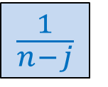

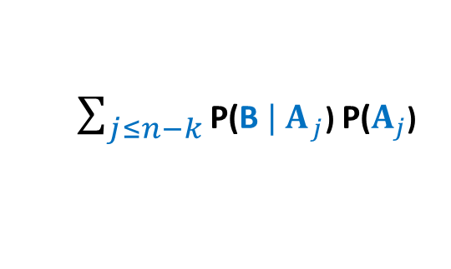

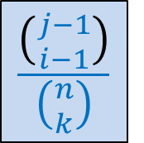
B :
the best person is selected.
$A_{j}$ :
“the $j$th best” candidate is
the best among first $k$ applicants
$\text{P}\text{(}\text{B}$) =
$\sum_{j≤n−k}{\text{P}\text{(}{\text{B} | A}_{j}}$) $\text{P}\text{(}A_{j}$)
$$\frac{1}{n−j}$$
B
$$\frac{\left({j−1 \atop i−1}\right)}{\left({n \atop k}\right)}$$
Ω
$$1 2 k n$$
Try to pursue this approach …

Slide 15




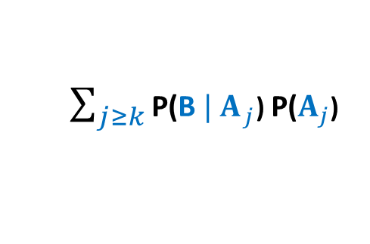



Homework: Use partition theorem carefully to calculate this probability.
B :
the best person is selected.
$A_{j}$ :
“the best” candidate is
occupying the $j$th place
$\text{P}\text{(}\text{B}$) =
$\sum_{j≥k}{\text{P}\text{(}{\text{B} | A}_{j}}$) $\text{P}\text{(}A_{j}$)
$$?$$
$$\frac{1}{n}$$
B
Ω
$$j$$
$$1 2 k n$$
Hint:
Under what conditions will
the best applicant be selected if $A_{j}$ happens ?
Answer:
the best among the first $j−1$ applicants
is occupying a position among the first $k$.

